Slide 1
MRI BASIC SAFETY
2014 Leadership Meeting

Slide 2
Objectives:
Understand the dangers of MRI and how to avoid them
Be able to identify the different types of safety hazards in MR
Become familiar with the basic MR procedures to be able to perform them or assist an MR expert to perform them safely

Slide 3
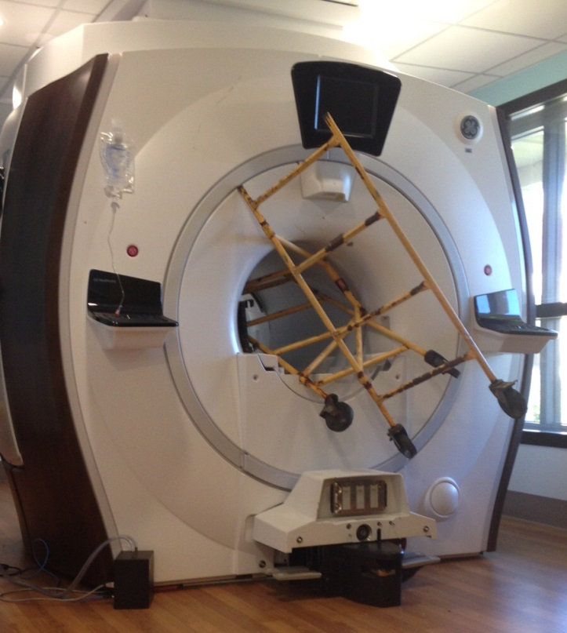
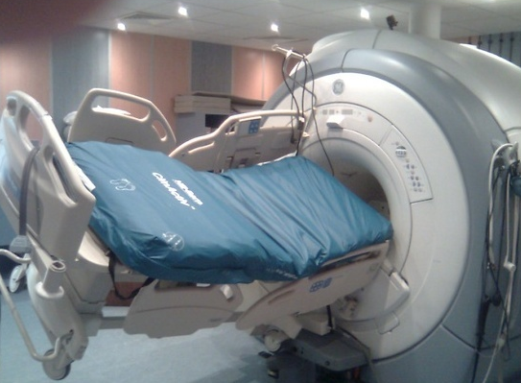
MR SAFETY HAZARDS:
Electrical hazard
Magnetic Field
Mechanical hazard
Cryogens and compressed gas
RF energy

Slide 4
Electrical hazards:
Line voltage 480V three phase delta
500-1000VDC:
SSM or Driver Module
Hybrid splitter
Bias lines
Coils
High voltage and currents:
Back of the gradients
Gradient filter connections in both sides of the penetration panel
Gradient coil connections
PDU incoming Power connections

Slide 5
Magnetic Field:
The invisible force 30,000 to 60,000 the earths magnetic force
It is exponential and it will surprise you
Empty your pockets and get used to checking yourself before you enter the magnet room every time
5 Gauss line is the safety limit established by the FDA. Passed this line there can be no pacemakers, implants or other devices or metal objects.
Absolutely no ferrous objects or tools at any time in the magnet
Do not play with ferrous objects or tools to feel the force
Difference between quenching and ramping
Special attention and two engineers required in some instances when working with the ferrous MRI components, i.e. dock assembly, coldhead, passive shimming.
Never assume that things in the room are non-ferrous, i.e. floor tiles, tools, and hand held vacuums.

Slide 6
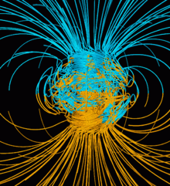
Magnetic Field:
Earth's magnetic field, also known as the geomagnetic field, is the magnetic field that extends from the Earth's interior out into space, where it meets the solar wind, a stream of charged particles emanating from the Sun. Its magnitude at the Earth's surface ranges from 25 to 65 micro-Tesla (0.25 to 0.65 gauss).
https://en.wikipedia.org/wiki/Earth%27s_magnetic_field

Slide 7
Mechanical hazards:
Risk of pinching due to moving parts
Pay attention when working on the patient table without the covers
High risk in the motor/gear assembly for the cradle movement in the rear pedestal
Never move the table unless you communicate with the other people in the room.
Just a few things listed here to look out for.

Slide 8
Cryogens and gasses:
MRI uses liquid He, He gas, and on occasions, liquid nitrogen and gas.
He gas is lighter than oxygen
He gas is odorless, colorless, tasteless
Ensure exhaust fan is on and door is open prior to working with He
Utilize the MR buddy system. Talk often, don’t distract each other.
High risk of burns with liquid oxygen
Liquid He is 4K or -473F
Look out for frozen pipes and use long sleeves, He gloves and safety glasses

Slide 9
What to do in a quench or cryogen related emergency:
Do not take a deep breath.
Hold the air you have and try to stay low and leave the room
If door does not open due to negative pressure break the window (LVShim phantom is great then!)
If somebody is unconscious in the room, call for help first, take a deep breath before going in and try to move the victim to a safe area
After everyone is safe call your TSM and RSM for assistance in caping the magnet.
Alert everyone in the vicinity of the incident. And report the quench to the proper authorities.

Slide 10
RF hazards:
MRI uses radio frequency energies up to 16kw for 1.5T and 36kw for 3T
Never disconnect RF connections while scanning
Be careful around:
the back of the RF amplifier
RF connections at the rear pedestal
RF connections on PEN panel and Driver Module
Use the disable RF toggle switch in the exciter board as a safety precaution when other people are around.

Slide 11
VIDEOS
4T Fun experiments and force testing:
https://www.youtube.com/watch?v=6BBx8BwLhqg
1.5T Experiment – NY accident:
https://www.youtube.com/watch?v=plvIEf7JsKo
Quench party:
https://www.youtube.com/watch?v=9SOUJP5dFEg
Magnet explosion:
https://www.youtube.com/watch?v=1R7KsfosV-o

Slide 12
YOUR SAFETY AND THE SAFETY OF THOSE AROUND YOU SHOULD BE THE NUMBER ONE PRIORITY AT ALL TIMES!!

